Slide 1
-ible
‘ible’ as in ‘possible’
Term 2 Week 8

Slide 2
This week’s words
terrible
horrible
possible
visible
edible
sensible
destructible
collapsible
responsible
forcible
legible
reversible
invincible
audible
permissible

Slide 3
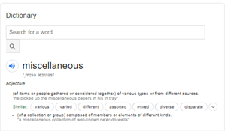
Monday - Meaning Explanation
This is where you explain what you know about the word.
You can look it up, but you need to put it into your own words.
Miscellaneous (adjective) - A group of things from different sources.

Slide 4
Tuesday - Complex or Descriptive Sentence
A complex sentence contains an independent clause, conjunction and dependent clause.
The phosphorescent light was not dangerous, however it was not healthy to sit near it for extended periods of time.

Slide 5
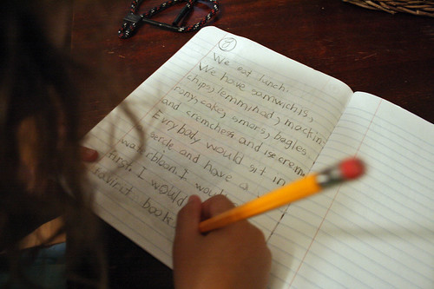
Wednesday - LSNCWC

Slide 6
Thursday - Literacy Planet

Slide 7
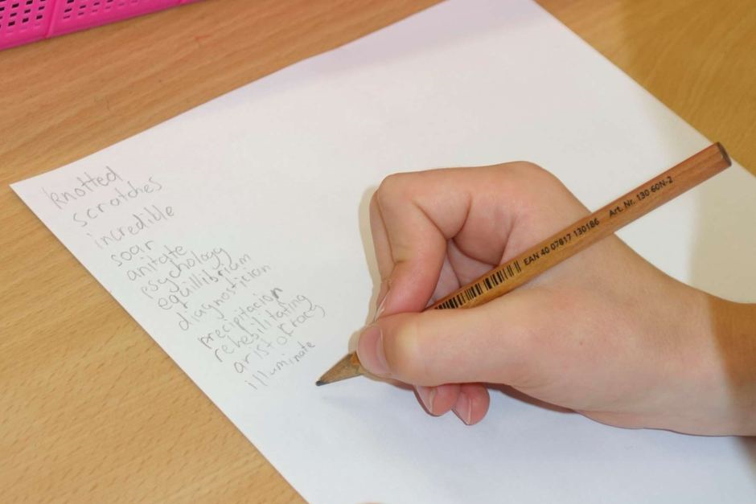
Friday - Spelling Test

