Slide 1
Journal Writing
SC: I can create an interesting insert for my journal to show how I have developed as a person
Term 2 Week 8

Slide 2
Frequently Asked Questions
Do I have to put my journal in the time capsule?
No, you can keep it somewhere else if you like, or just put a page in the time capsule.
Do I have to share it with my teacher if it is personal?
No, you can show the teacher parts of the journal you are comfortable with.
Can I do lots of drawing?
YES! The artwork is just as important as the writing. Draw, decorate and create as much as you like. There does not need to be a lot of writing.

Slide 3
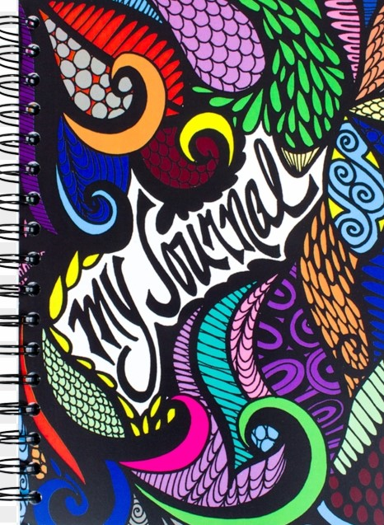
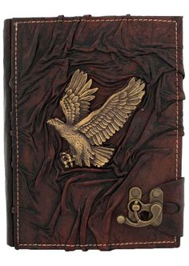
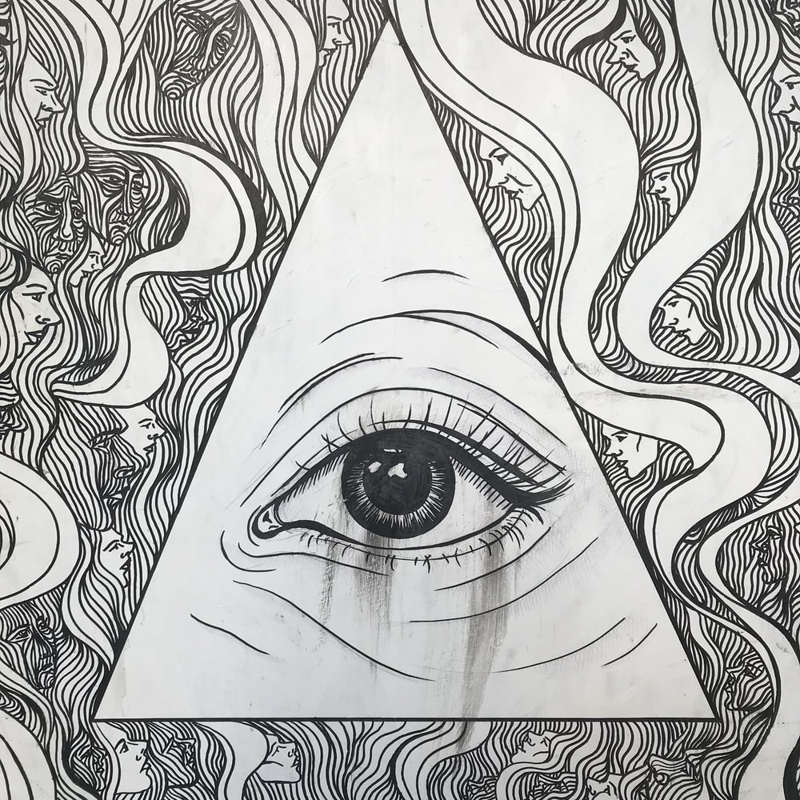
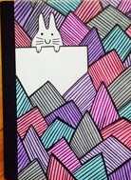
The halfway point
This WEEK marks the ‘halfway point’ of journal writing. Now is a great time to reread, improve, add and reflect.

Slide 4
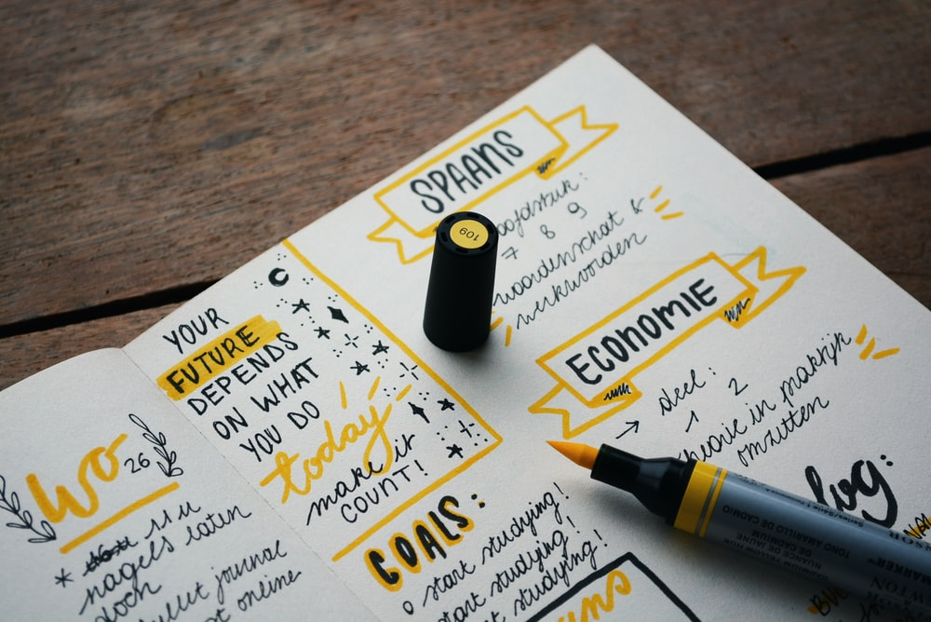
REREAD AND IMPROVE
PROOF READING AND EDITING CAN ACTUALLY LOOK COOL, ESPECIALLY WHEN YOU USE DIFFERENT COLOURS AND HIGHLIGHTS.

Slide 5
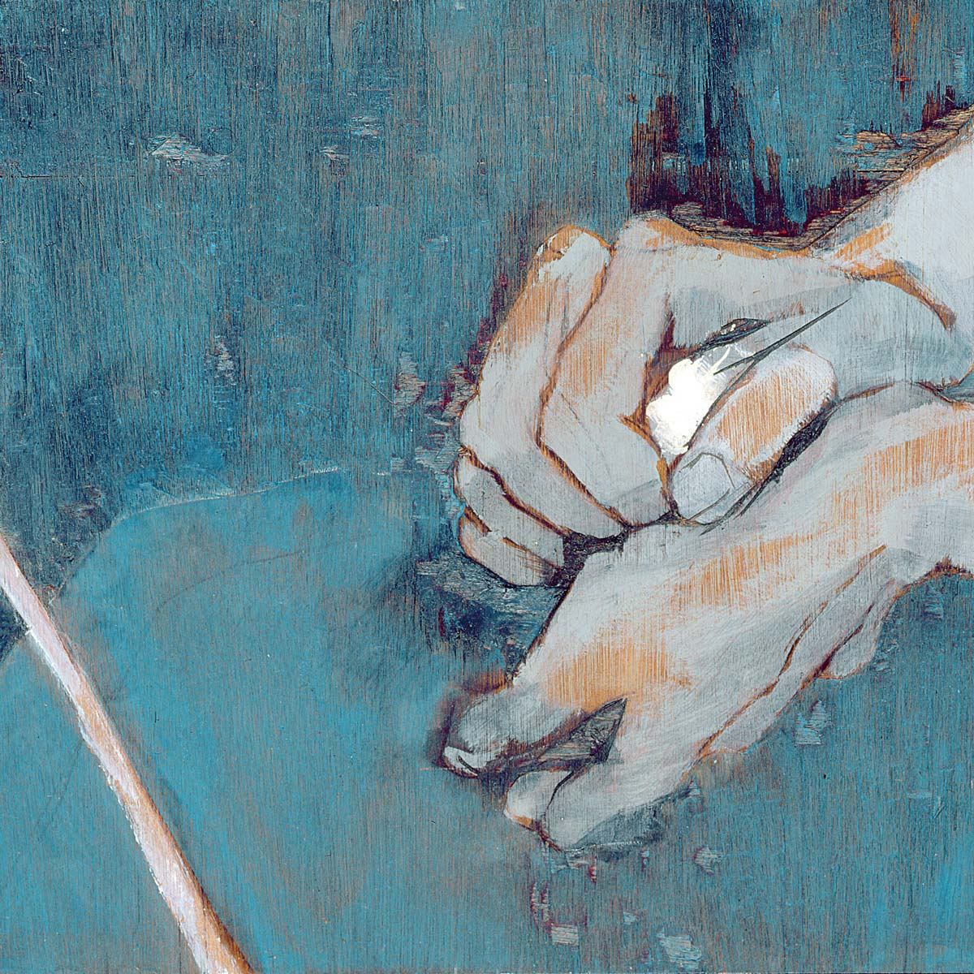
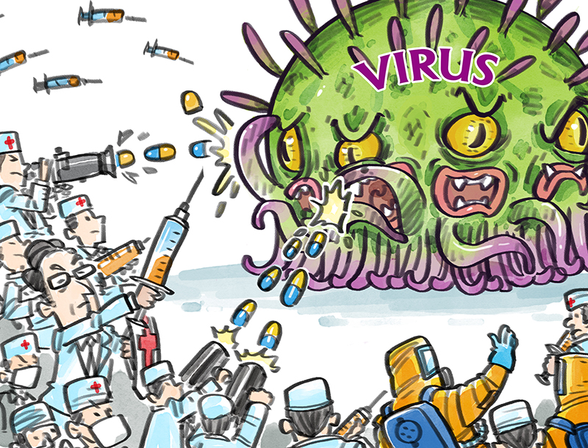
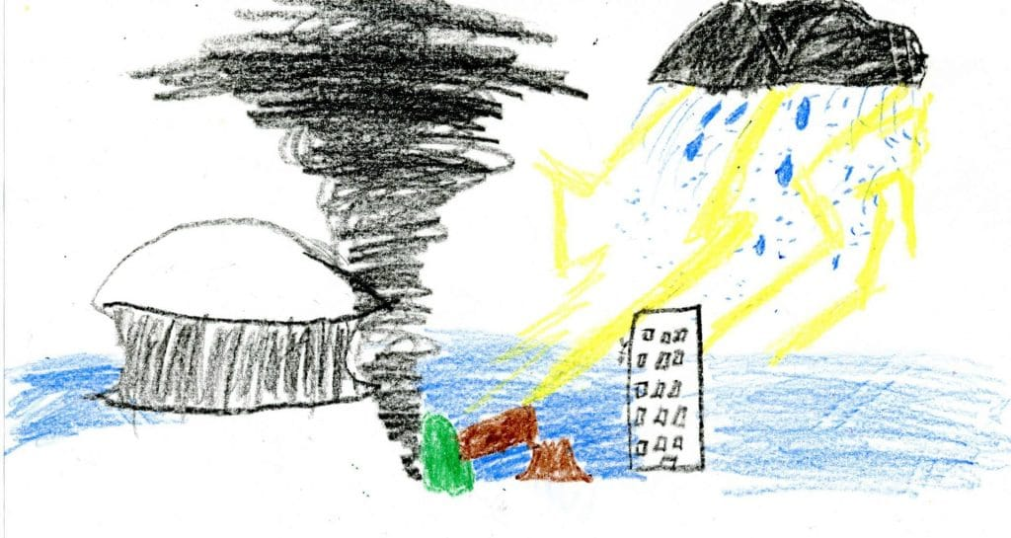
ADDING AN INSERT
ADDING AN INSERT CAN REALLY ENHANCE YOUR JOURNAL. THIS IS A ‘PICTURE PAGE’, OFTEN FOUND IN THE MIDDLE OF BIOGRAPHIES AND AUTOBIOGRAPHIES. DEDICATE AN ENTIRE PAGE ON THE LEFT HAND SIDE TO DRAW A PICTURE THAT SUMS UP YOUR EXPERIENCE DURING THE COVID-19 PANDEMIC.

Slide 6
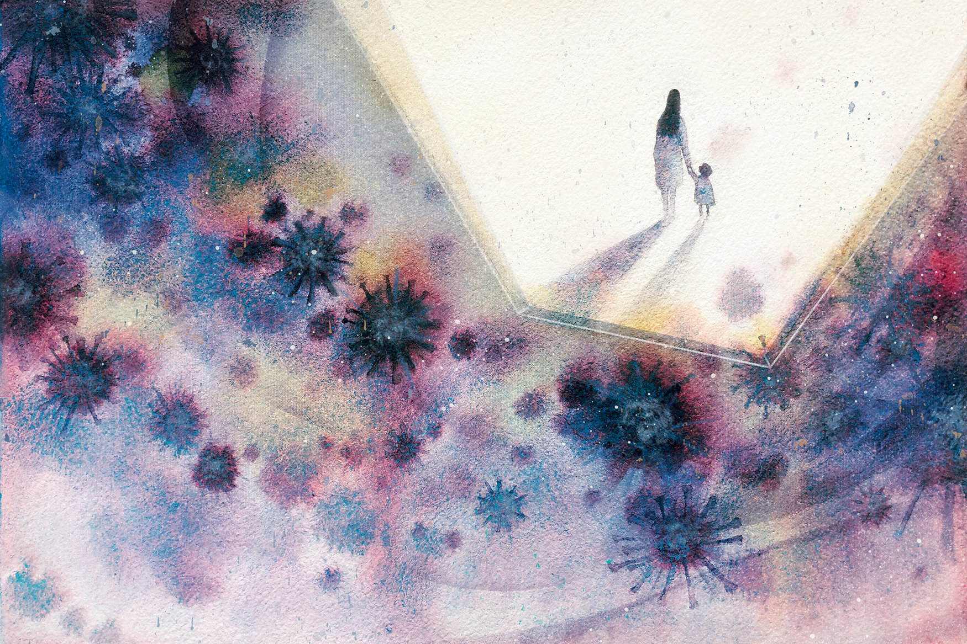
ADDING AN INSERT

Slide 7
ANSWERING REFLECTIVE QUESTIONS
ON THE OPPOSITE PAGE,YOU WILL ANSWER REFLECTIVE QUESTIONS ABOUT YOUR DEVELOPMENT AS A PERSON DURING THE PANDEMIC. THIS IS ALSO YOUR PERSONAL LEARNING TASK FOR THE WEEK.
How has the pandemic developed my resilience?
Am I a better person after the pandemic? Why/why not?
What have I learnt about myself?
What is a new or improved skill I now have?

Slide 8
Journal Tasks week 8
Monday – Proofread and edit ALL journal entries
Tuesday and Wednesday – Draw your ‘insert’ on the left hand page
Thursday – Write and answer the Personal Learning questions on the right hand page
Friday – Add more artwork around your entries

