Slide 1
Teacher Notes

Slide 3
Symbols
I do: my turn to talk. This is the explanation section of our lesson where you are required to listen.
We do: this is where we discuss or work on the concepts together.
You do: your turn to be involved. You may be working in a group or on an activity individually.

Slide 5
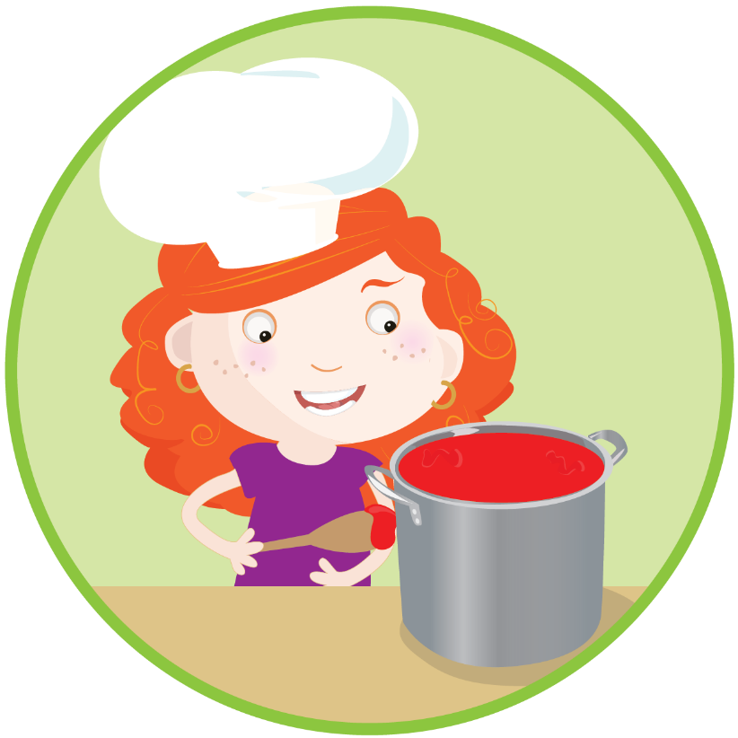
Procedure Text - Overview
Procedure texts inform how to do or make something through a series of steps.
There are many types of procedure texts, such as:
recipes
instructions
directions
rules.

Slide 6
Procedure Text Structure
Title | This is a clear statement about what you are going to do or make.
Materials/Ingredients | This is a list of items that you will need to complete the task.
Method | This is a series of ordered steps explaining how to complete the task.

Slide 7
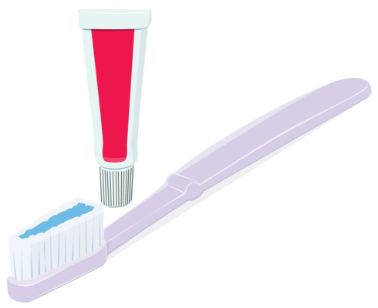
How to Brush Your Teeth
Materials
Toothbrush
Toothpaste
Water
Method
Squeeze some toothpaste on the toothbrush.
Put your toothbrush under some water.
Brush your teeth thoroughly for three minutes.
Rinse your mouth and the toothbrush with water.

Slide 8
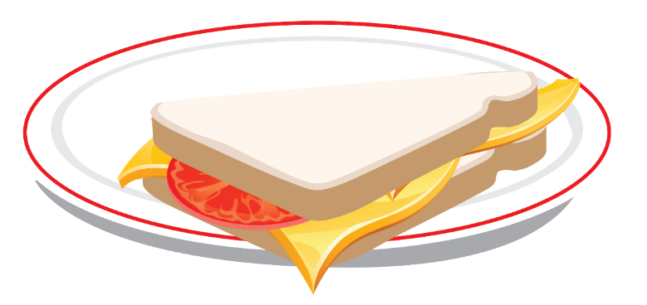
How to Make a Cheese Sandwich
Ingredients
2 slices of bread
1 slice of cheese
Butter
A knife
A chopping board
Method
Lay the slices of bread on the chopping board.
Carefully spread the butter on the slices of bread.
Lay the cheese on top of one of the slices of bread.
Place the other slice of bread on top of the cheese.
Carefully cut the sandwich in half and place it onto a small plate.

Slide 9
Procedure Texts - Language
Procedure texts use clear and direct language. They use words that are related to the topic of the procedure.
Here are some examples of the language you might find in procedure:
common nouns
action verbs
‘ly’ adverbs
adverbial phrases.

Slide 10
Language in Procedure Texts
Common Nouns
A common noun is a person, place or thing.
Action Verbs
An action verb is a doing word.
Adverbs
An adverb describes a verb.
Adverbial Phrase
An adverbial phrase tells when, where or how.

Slide 11
Procedure Text Language - Example
Common Nouns | Squeeze some toothpaste on the toothbrush.
Action Verbs | Put your toothbrush under some water.
Adverbs | Brush your teeth thoroughly for three minutes.
Adverbial Phrase | Rinse your mouth and the toothbrush with water.

Slide 12
Plan & Draft
The first thing you need to do is decide what topic you are going to create a procedural text about. You are trying to ‘teach’ another person how to do something following simple step by step instructions. The examples given are quite basic as they are showing you the required structure. Be adventurous with what you decide to do! Be sure to include every step that is involved.
It can be a recipe
It can be an instructional manual describing how to create something like an origami crane.
It can be something you have made out of recyclable materials found around your home.

